Slide 1
In The Name Of Allah

Slide 2
Spyware & Antispyware
Spyware & Antispyware

Slide 3
Spyware & Antispyware
Spyware & its History

Slide 4
Spyware & Antispyware
What is Spyware?
Spyware refers to programs that use our Internet connection to send information from our personal computer to some other computer, normally without our knowledge or permission.

Slide 5
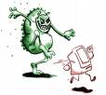
Spyware & Antispyware
What is Spyware?
In General:
Do not work as viruses
Create unwanted: CPU activity Disk usage Network traffic
Rarely "lives" alone

Slide 6
Spyware & Antispyware
First Spyware
These first viruses weren't dangerous only meant as a bit of fun.
People have always been looking for a way to use the internet to make money.
In the 1990's people started advertising on the internet as a way to promote their businesses.
Internet marketing was initially used to promote all sorts of things.
Banner adverts and text links were common types of advertising campaigns.
The first known use of the expression "spyware" occurred on October 17th, 1994 in a post that joked about Microsoft's business model.

Slide 7
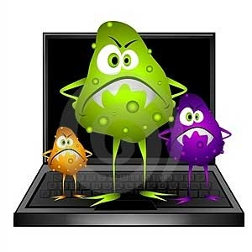
Spyware & Antispyware
Spyware’s Evolution
October 17th 1994: Usenet: Making fun at MS business model
Early 2000: First reports of “spyware” - Aureate
2000: First anti-“spyware” software OptOut About 6 known spyware + about 5 possible spyware
January 26th 2001: Press release: ZoneAlarm Personal Firewall

Slide 8
Spyware & Antispyware
Spyware in 21st century
Saturday, 25 Jan 2003 — A New Worm is Loose The worm is known by the names "SQL Sapphire”.
In 2005, spywares came in the form of Active-X controls, with ads, as a browser-hijacks.
Since then, the computer-community has used the term in its current definition.
Notes:
A new worm exploded onto the Internet, causing worldwide traffic congestion as it aggressively replicated by searching for vulnerable and unpatched Microsoft Windows servers running the SQL database engine.

Slide 10
Spyware & Antispyware
How Spyware Infects?
It will only be installed onto computers if someone runs the install program of an infected program.
It is commonly bundled with illegal software and freeware.

Slide 11
Spyware & Antispyware
Type’s Of Spyware
Adware, Malware, Stealware
Pop-up
Identity theft
Dialers
Cookies
DRM - Rootkit

Slide 12
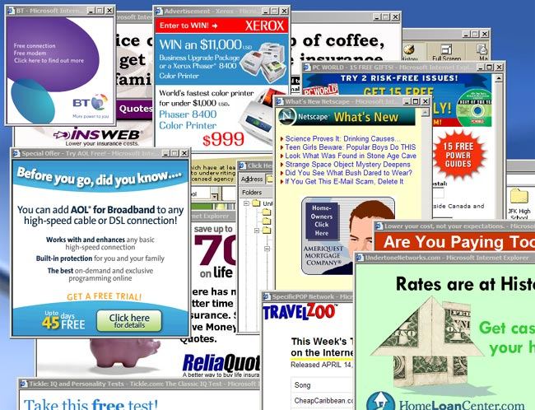
Spyware & Antispyware

Slide 13
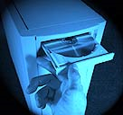
Spyware & Antispyware
How Spyware comes?
Spyware can be downloaded from Web sites, email messages, instant messages
Spyware often comes from direct file-sharing connections like KAZAA, UTORRENT, RAPIDSHARE.
Spyware often comes wrapped-in with shareware or other software, and with music CDs.

Slide 14
Spyware & Antispyware
Classification Of Spyware
Spyware
Keyloggers & password recorders
Commercial
domestic
E-mail & Screen Recorders
Modem Hijacking
PC Hi-jacking
Web Bugs
Ad-wares
Browser-Hijacks
Trojans & Viruses

Slide 15
Spyware & Antispyware
A look at the Present

Slide 16
Spyware & Antispyware
More than 54000 spyware fingerprints, Ad-Aware
More than 300 Millions Infected.
Today:

Slide 17
Spyware & Antispyware
Spyware in 2009-10
A Threat, 300 million and over 70% computers are infected with
The usual solution people find is to format their drives after being attacked with these bugs
Google, msn and various search engines now needs to confirm and test the actual user process differing it from the automated queries
The spywares footprints are increasing by everyday life yet antispyware soft wares are updating their trackers daily too

Slide 18
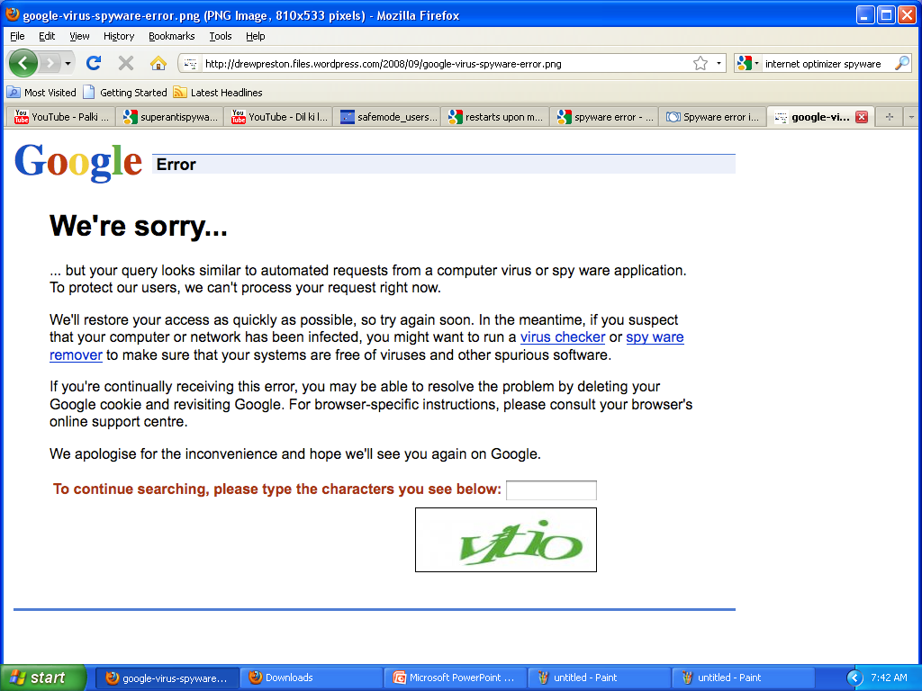

Slide 19
Spyware & Antispyware
Let Us Have a Quick Review On Top 10 Spywares Of 21st century

Slide 20
Spyware & Antispyware
Following are the top Spywares
CoolWebSearch
Gator
180search Assistant
InternetOptimizer
Hot as Hell
Advanced Keylogger
TIBs dialer

Slide 21
Spyware & Antispyware

Slide 22
Spyware & Antispyware
Pop-up, rewrite search, change host file
Recent variants of CoolWebSearch install using malicious HTML applications or security flaws Such as exploits in the HTML Help format and Microsoft Java virtual machines.
CoolWebSearch

Slide 23
Spyware & Antispyware
Gator (GAIN)
Gator is an adware program that may display banner advertisements based on user Web surfing habits.
Gator is usually bundled with numerous free software programs, including the popular file-sharing program Kazaa.

Slide 24
Spyware & Antispyware
Redirect IE error pages to ads
Internet Optimizer

Slide 25
Spyware & Antispyware

Slide 26
Spyware & Antispyware
A few typical examples of spyware

Slide 29
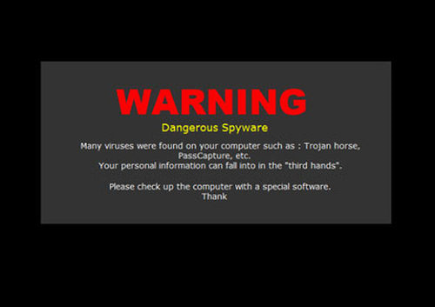
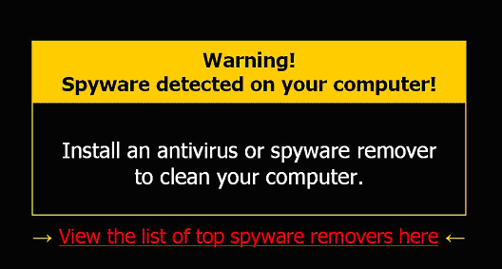
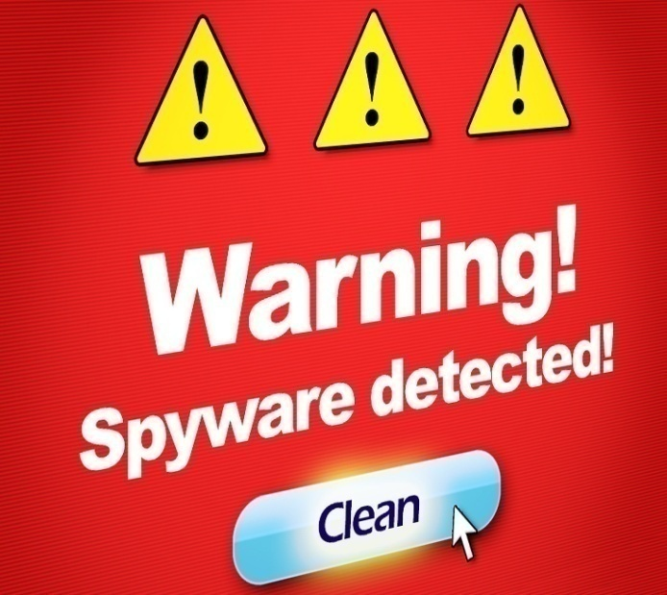
Spyware & Antispyware
NEVER CLICK THESE!!!!

Slide 30
Spyware & Antispyware
NEVER CLICK THESE!!!!

Slide 31
Spyware & Antispyware
Antispyware & manual removal techniques

Slide 32
Spyware & Antispyware
Antispyware
Designed or intended to combat or eliminate spyware on a computer system

Slide 33
Spyware & Antispyware
Good practices on the internet
Change browser (e.g. Mozilla, opera, chrome)
Do not download executables
Only download from vendors or well-checked sites
Watch out for cookies
Avoid HTML e-mails – Use plaintext
Read EULA
Avoid drive-by download – Change security level

Slide 34
Spyware & Antispyware
Best antispywares around the globe
Superantispyware
Spy Sweeper
Ad-Aware
Windows Defender
Spyware Eliminator
Counter Spy
**Spy Deleter – Installs spyware

Slide 35
Spyware & Antispyware
How antispyware works
A spyware remover actively scans your computer for spyware by analyzing the codes comparing these to its database of known spyware definitions
The key to effective spyware detection is the cleaner's definitions database that's provided by the software publisher.
The larger the database, the more spyware the cleaner can identify and remove.

Slide 36
Spyware & Antispyware
Adware cookies
Trackers
Phishing spywares
ANTISPYWARES

Slide 37
Spyware & Antispyware
A short tutorial to

Slide 38
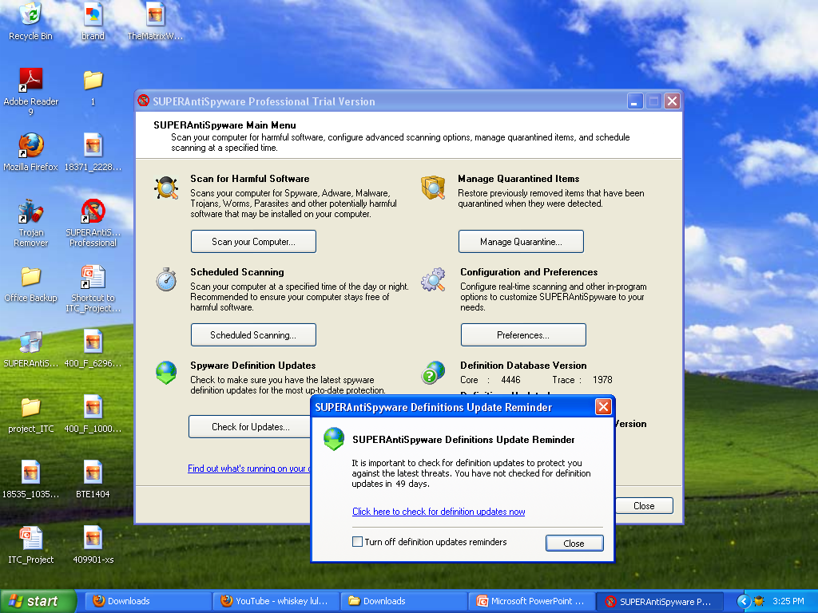

Slide 39
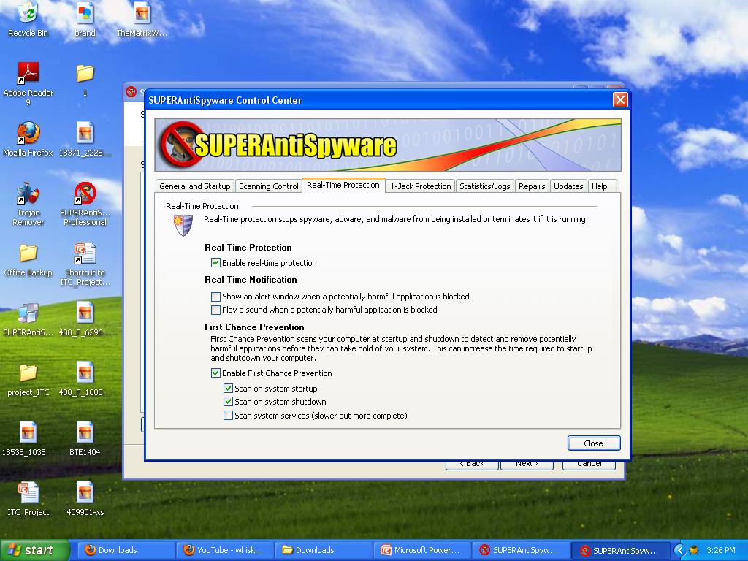

Slide 40
Safemode Scan
Spyware & Antispyware
The best scan that we can have on our PC is turning the Safe-Mode on and have a scan
Safe-mode enables a user to work with the least enabled devices and utilities
Even most of the drivers are disabled in a safe-mode
A low resolution profile can be seen once safe-mode is turned on

Slide 41
Spyware & Antispyware
SAFE-MODE
A short tutorial to

Slide 42
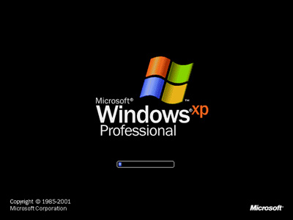

Slide 43
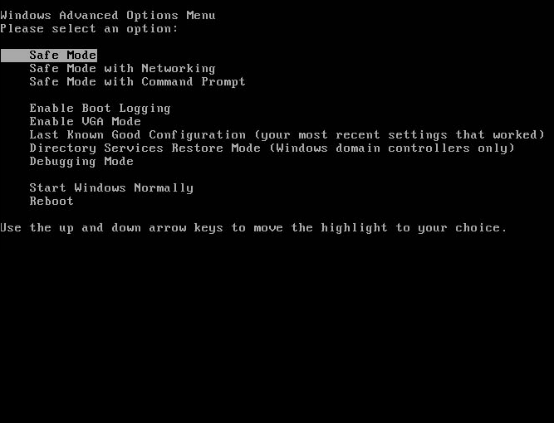

Slide 45
Spyware & Antispyware
Scanning in Safe-mode
Now what you do is that you locally run your antispyware program from the start menu,
Running the program, you can have thorough scan of the system including the drivers and the items that occupy

Slide 46
Spyware & Antispyware
What google can do for us?
Google is a search engine, we all know, but this can benefit you in some more ways.
Let us see how google would help you removing a spyware manually

Slide 47
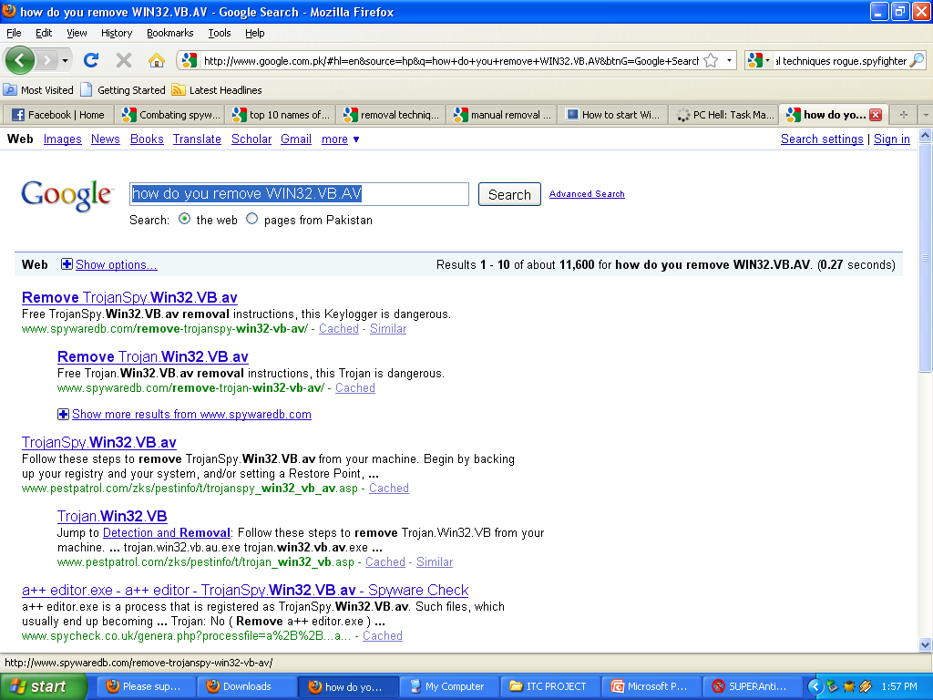

Slide 48
Spyware & Antispyware
Overlooking the Task manager
Task-manager, ms utility to manage the processes
Helps to terminate the spywares and remove them manually.
Terminate a program, not working.
Terminate programs, not in use

Slide 49
Spyware & Antispyware
A short tutorial to task-manager
A Combo of the keys CTRL, ALT & DEL at any time in windows runtime mode opens a box termed as task-manager
Once opened, go upon processes and see which process to terminate
This terminology of terminating a process helps you delete spywares from the root directory
The root directory for most spywares is C:/Windows/System32

Slide 50
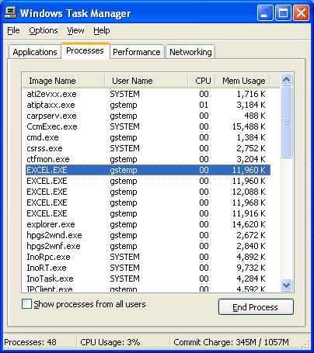
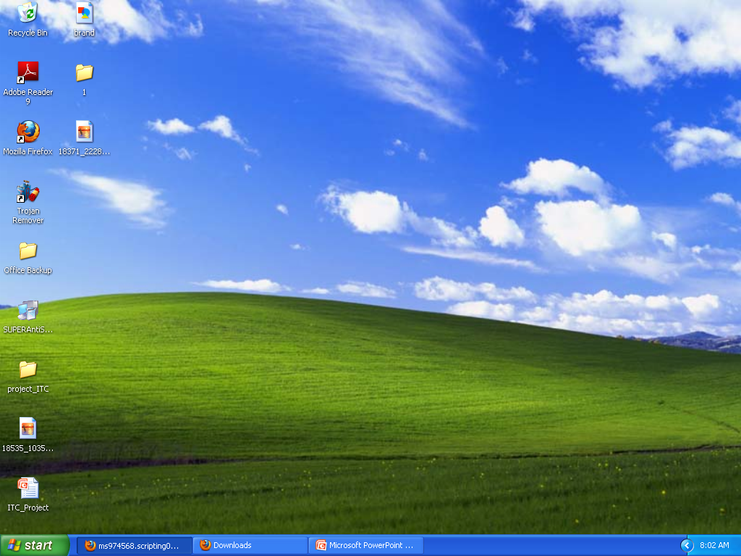

Slide 51
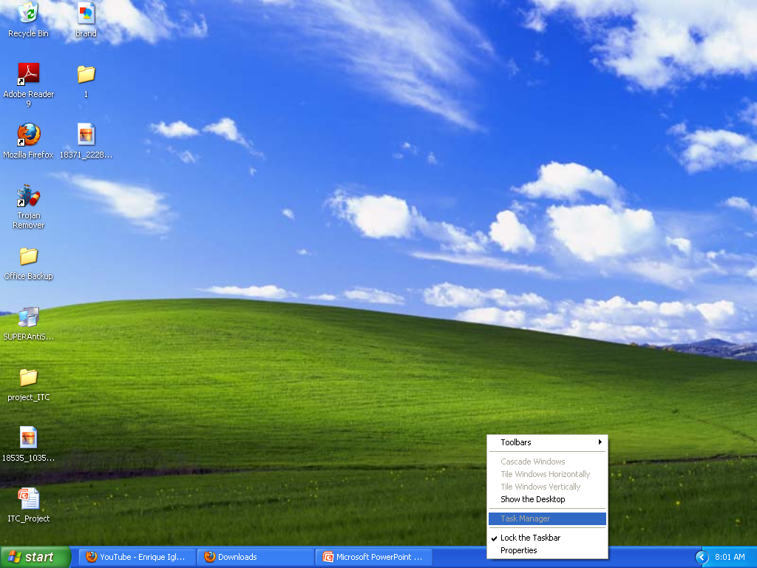

Slide 52
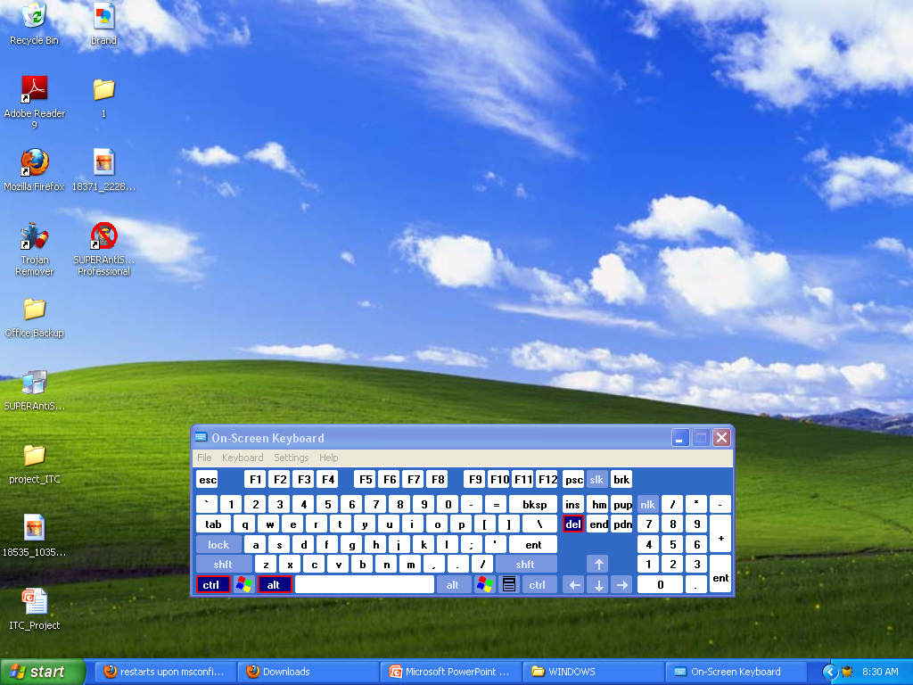

Slide 53
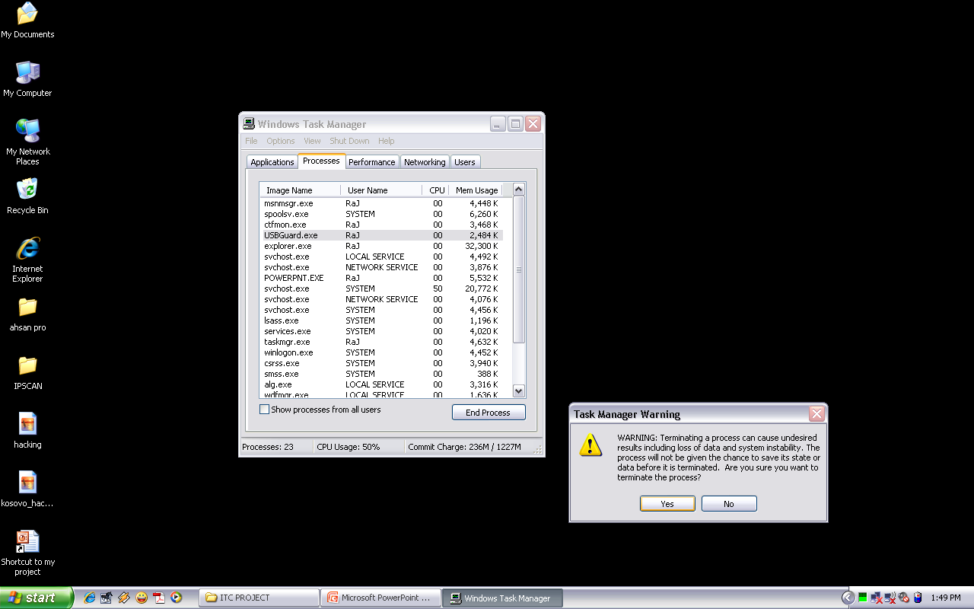

Slide 54
Spyware & Antispyware
A known spyware is generally terminated and then deleted from the registry and from the root directory after terminating it from the processes
The spywares can manually be terminated only if you’re aware of the system’s processes.
The processes include drivers, running applications and spywares as well.
Spywares and spywares usually show up under the user section

Slide 55
Spyware & Antispyware
Msconfig
Another ms-utility that enables ms. Windows users to edit the start-up processes configurations
With this utility you can stop spywares to run at the start-up.

Slide 56
Spyware & Antispyware
A short tutorial to
Msconfig

Slide 57
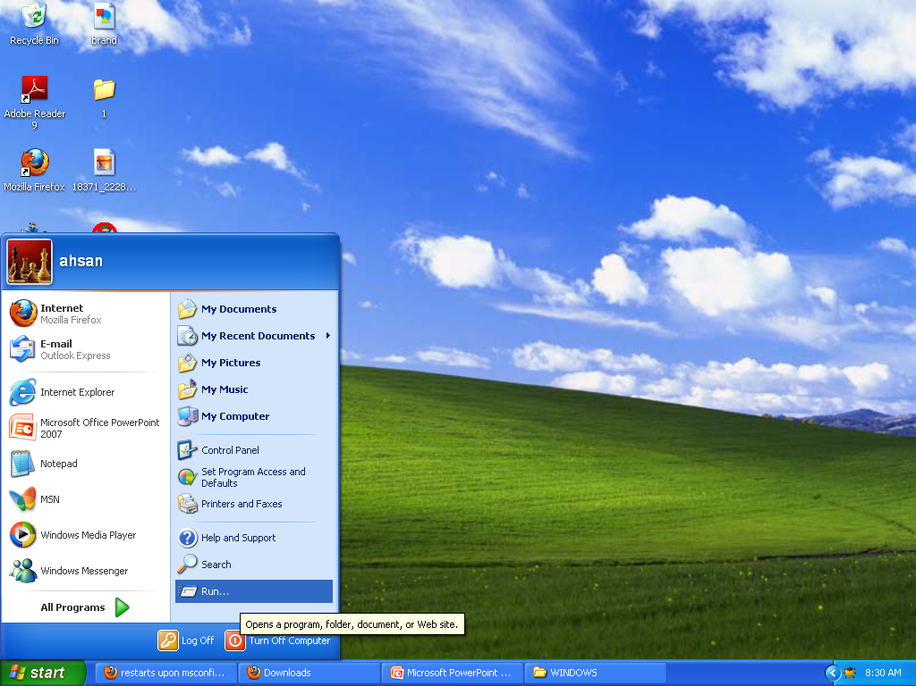

Slide 58
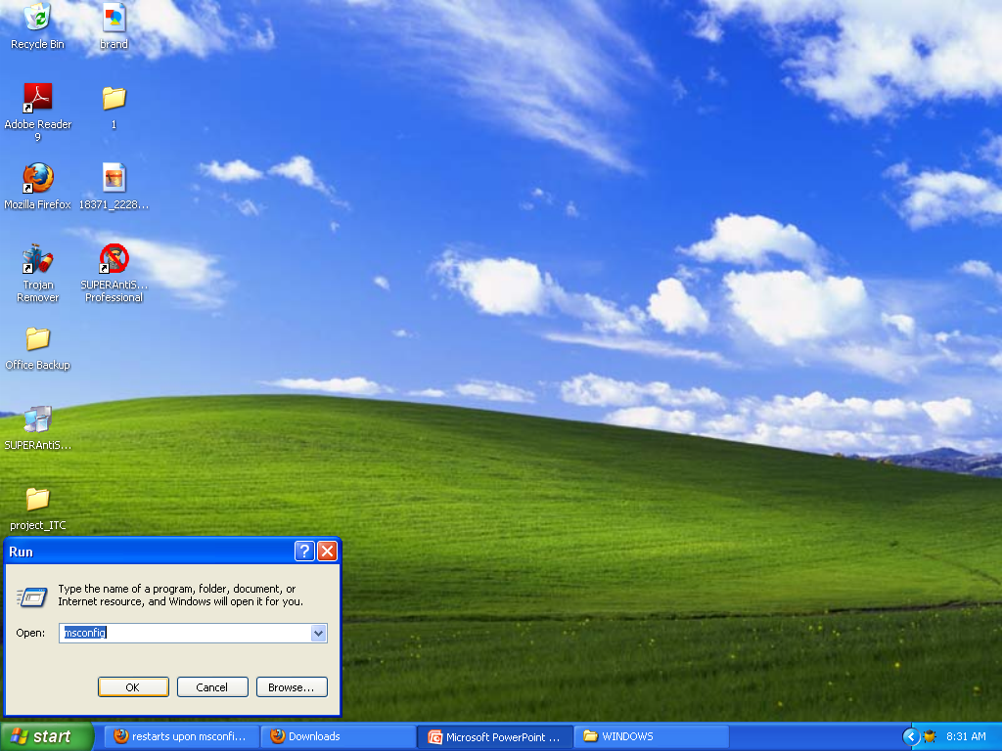

Slide 59
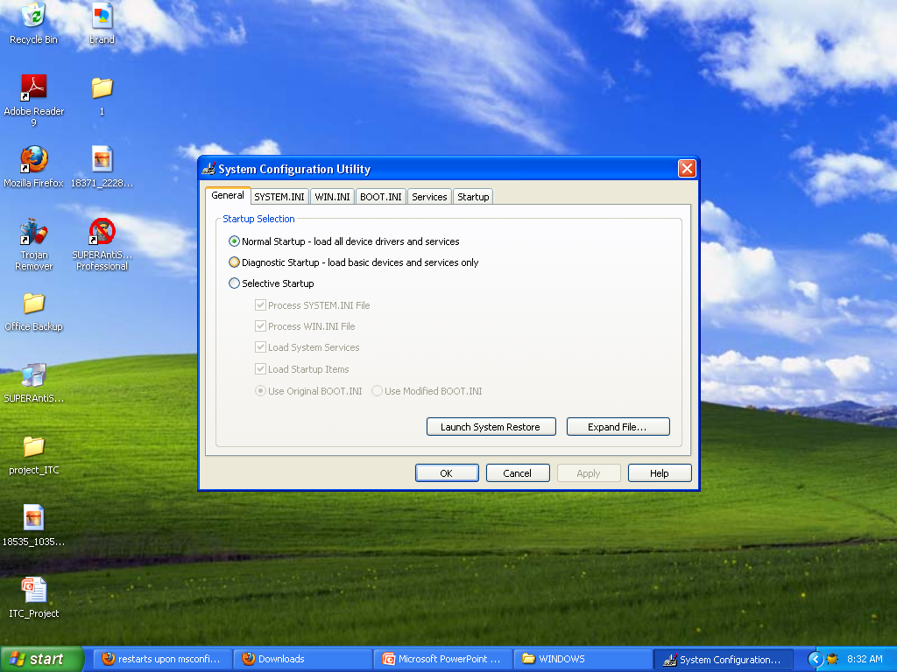

Slide 60
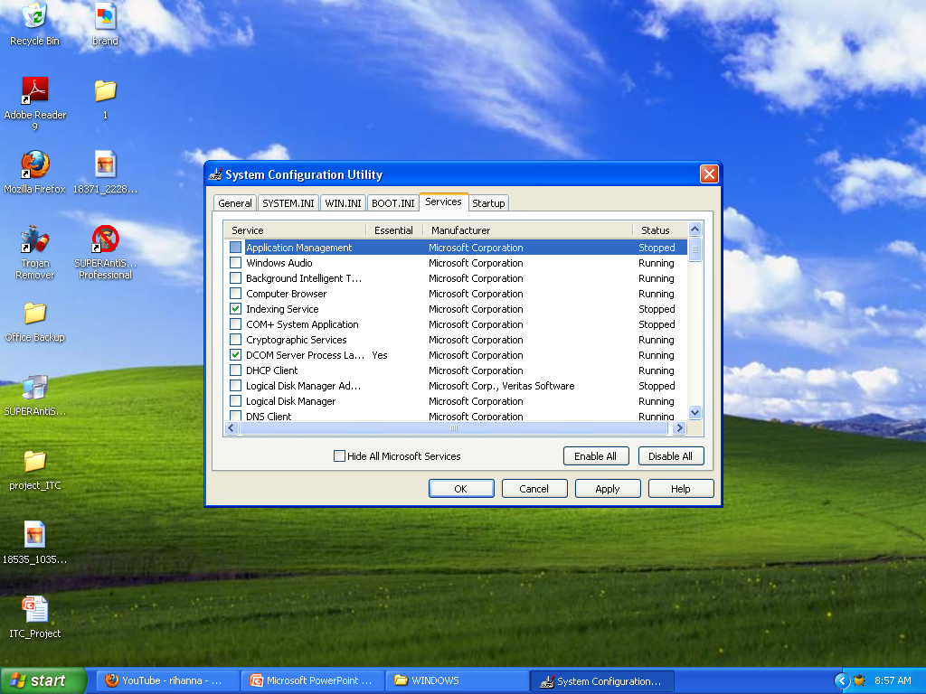

Slide 62
Spyware & Antispyware
Regedit
Lets you play with the registry of softwares and hardwares
Now see the Tutorial.

Slide 63
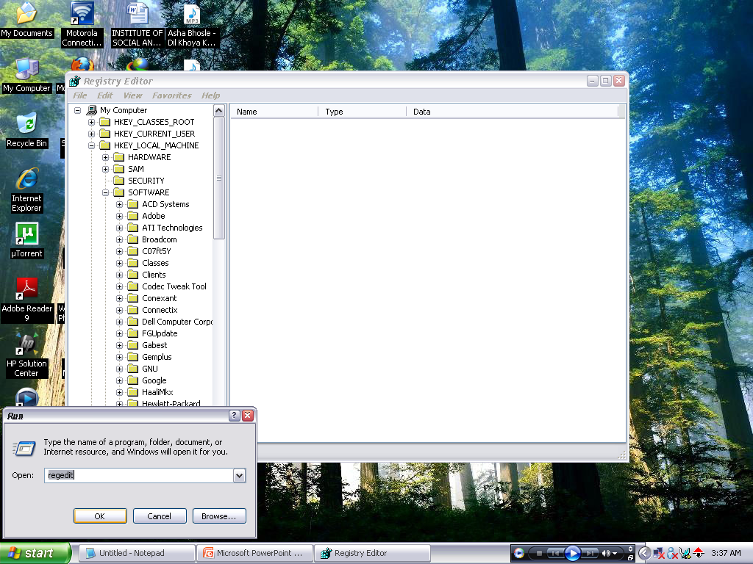

Slide 65
Spyware & Antispyware
References
http://www.wikipedia.org/
http://www.microsoft.com/
http://www.grc.com/
http://www.spywarewarrior.com/
http://www.winsupersite.com/

Slide 66
Spyware & Antispyware
These tutorials and presentation was giving to you in hope that you can have a professional approach towards cleanin’ your system rather than formatting it.

Slide 67
Spyware & Antispyware
Thanks To all of you for letting us host this presentation

